Slide 1
Convince us!
The art of rhetoric
in writing

Slide 2
Imagine this scenario…
You are a brand-new student at Middle College, and, during Club Rush, you venture over to the club tables. Your schedule only has room for one club. You see tables for three groups—the Esperanza Club, the Hope Club and the Challenge Club—and, when you read the descriptions of each club’s activities, they sound almost identical.

Slide 3
Three seniors, however, are sitting at the registration tables. You introduce yourself and learn that they are the presidents of the three clubs.
You ask them which club you should join, and each one gives you different advice:

Slide 4
Student #1 says:
“Trust me, the Esperanza Club is the best. I’m the only student at Middle College, as far as I know, who’s belonged to every club. The last three years, I’ve joined every club at least once, and the Esperanza Club is far and away the most fun and educational. Plus, I’m president this year, so I guarantee you it will be awesome.”

Slide 5
Student #2 says:
“You really ought to join the Hope Club. To keep a club going here, you need at least 10 members, and membership has fallen a lot since the adviser, Ms. Carter, got sick and missed a few months. Man, the Hope Club is her pride and joy. She built it from the ground up, and she’d be devastated if they cut it. Seriously, do her a favor and join us.”

Slide 6
Student #3 says:
“You’d get the most out of joining the Challenge Club. A truly great club helps to build your future, and our club will look the best on your college application. Also, the kinds of activities you do in the Challenge Club will help you understand a lot of your classwork. For your grades and your college and job potential, we’re your best choice.”

Slide 7
Each of these speakers uses…
rhetoric
(n). speech or writing that is intended to impress or influence people
(Basically, if we speak or write because we want something, we’re using rhetoric.)

Slide 8
We use rhetoric when…
we ask for a pay raise
we apply for a job
we give advice to
a younger sibling
we run for ASB
we convince our parents
to buy us a dog

Slide 9
Three main kinds of rhetoric
1. ethos: stressing trust/reputation
“You should believe me because I have the right experience and I know what I’m talking about.”
2. pathos: stressing emotions/morals
“You should believe me because it’s the right thing to do. You have a heart, don’t you?”
3. logos: stressing facts/logic
“You should believe me because I’ve thought this issue through and my argument makes sense.”

Slide 10
Our sample essay
“Hip Hop Planet” by James McBride
Published in National Geographic in 2007

Slide 11
As you read, consider…
How does McBride use ethos? What makes him qualified to write about hip hop?
How does McBride use pathos? Does he try to make you sympathize with anyone in the course of his article?
How does McBride use logos? Does he simply say that hip hop is important, or does he provide evidence/facts?

Slide 12
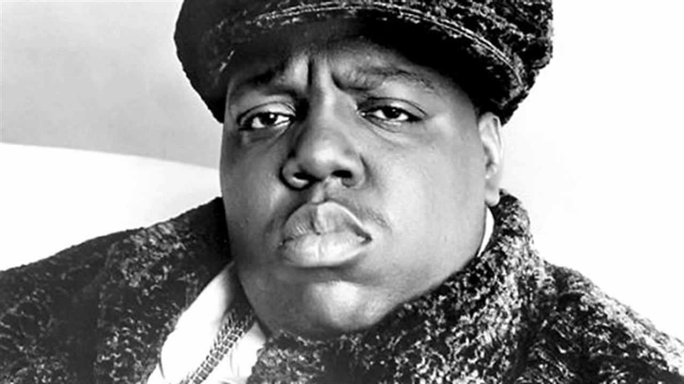
Let’s begin, then…

Slide 13
Complete these sentence stems
When I hear the phrase “hip hop,” I instantly think of ___________.
Hip hop is mostly about _____________.
Hip hop started _____________.
Hip hop has become popular because _______________.
Hip hop is best understood by _______________.

Slide 14
Predictions and questions
Based on the title, what do you think the article will be about?
What impressions do you get from paragraph one?
What do you think McBride will discuss in his article?
What would you ask McBride, so far, if you could?

Slide 15
Homework
Do Activity 8 in your packet
Highlight key ideas and phrases in “Hip Hop Planet”
Highlight at least one example each of ethos, pathos and logos
On one of the blank pages in your booklet, answer: (1) Did any of your predictions turn out to be true? (2) Did McBride answer any questions you asked?

